Slide 1
The Fundamentals of Machine Learning
Tim Pengajaran
Mata Kuliah Pembelajaran Mesin
Jurusan Teknologi Informasi Tahun 2022

Slide 2
Disclaimer
This presentation material, including examples, images, references are provided for informational and explanation assistance only
The names of actual products and companies mentioned here in, if any, may be the trademarks of their respective owners
Credits shall be given to the images taken from the open-source and cannot be used for promotional activities

Slide 3
Outline
The Relation between Artificial Intelligence and Machine Learning
What is Machine Learning?
Why Machine Learning
The Most Essential Concept of Machine Learning
How Machine Learning becomes Intelligent?
How to Measure the Performance of Machine Learning?
An Introduction to Scikit-learn and Other Tools
A Brief on Google Colaboratory

Slide 4
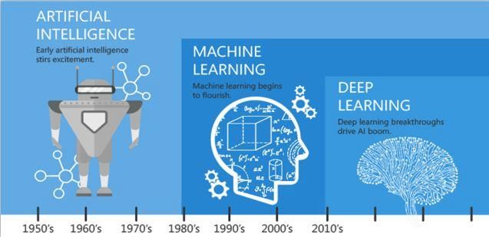
The Relation between AI and ML – The Emergence

Slide 5
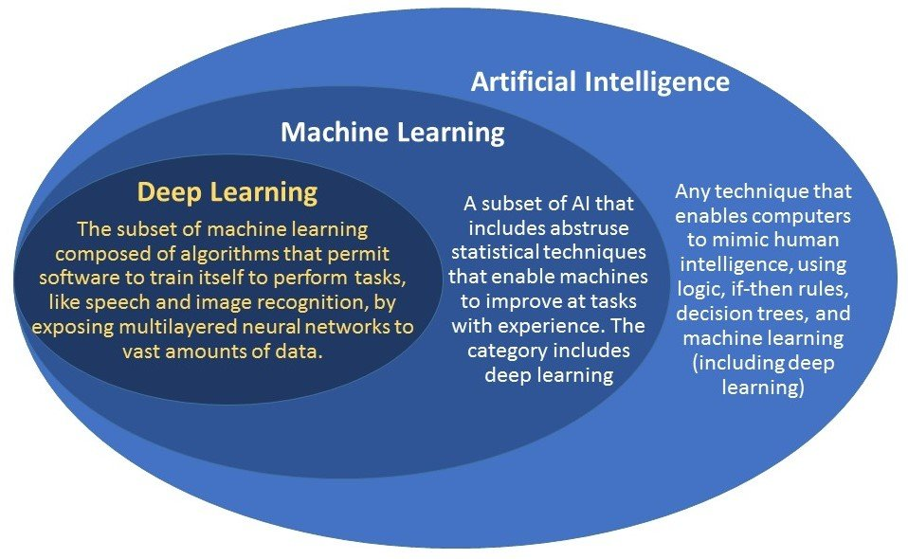
The Relation between AI and ML – The Level

Slide 6
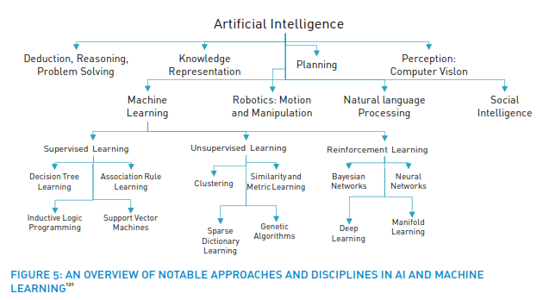
The Relation between AI and ML – The Tree

Slide 7
What is Machine Learning?
The design and study of software artifacts that use past experience to inform future decisions.
The study of programs that learn from data.
A program can be said to learn from experience 'E' with respect to some class of tasks 'T' and performance measure ‘P’ (Tom Mitchell’s Concept)

Slide 8
The Most Essential Concept of Machine Learning
Experiences (E)
Learning
Task (T)
Results
Performance (P)
Learning from Experiences
Like Humans Do

Slide 9
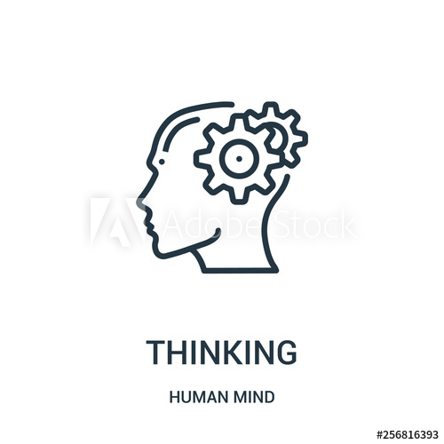
How Machine Learning becomes Intelligent?
Intelligence
Experiences
Lots of Data
Requires Time
Past Data
Learning develops Knowledge makes up Intelligence

Slide 10
Learning in Machine Learning
Focus on Supervised and Unsupervised Learning
Supervised Learning
A program predicts an output for an input by learning from pairs of labeled inputs and outputs.
The program learns from examples of the "right or correct answers“.
Unsupervised Learning
A program does not learn from labeled data.
The program attempts to discover patterns in data.
It cannot give label to the inputs.

Slide 11
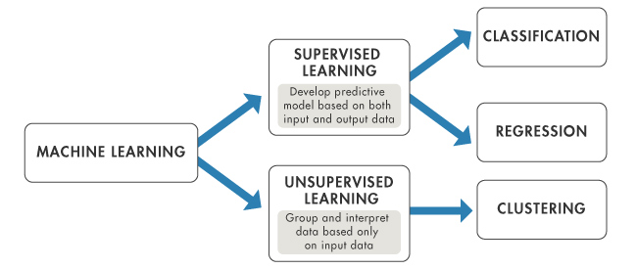
Machine Learning Tasks – Generic
DIMENSIONAL REDUCTION

Slide 12
Machine Learning Tasks
Dimensional Reduction
The process of discovering the features that account for the greatest changes in the response variable.
Can also be used to visualize data.
Unsupervised approach.

Slide 13
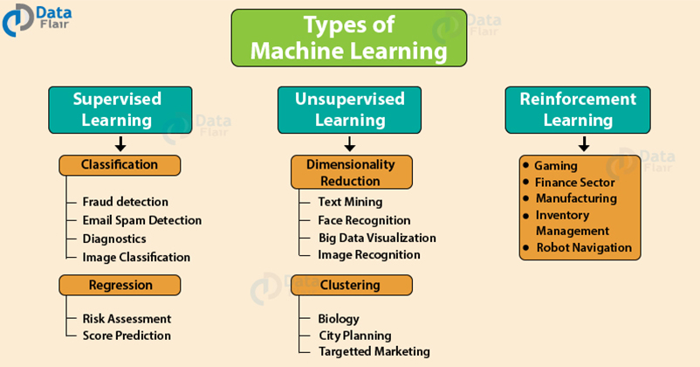

Slide 14
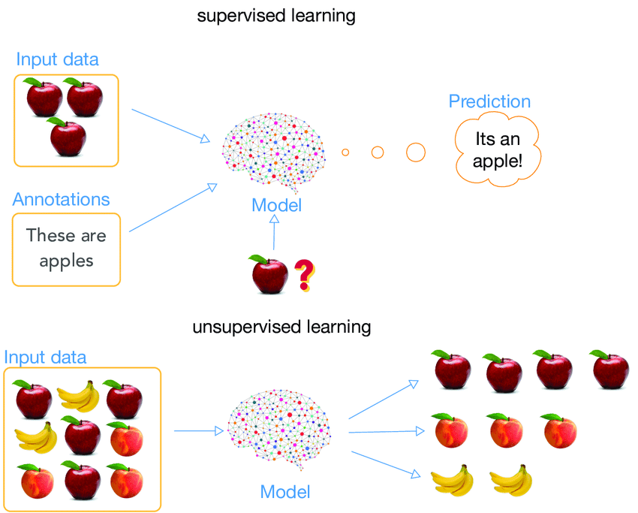
The Concept of Supervised Learning
‘T’
‘E’
‘P’

Slide 15
The Concept of Unsupervised Learning
‘T’
‘E’
‘P’

Slide 16
Training Data, Testing Data, and Validation Data
Training Data
A training set is a collection of observations.
Testing Data
The test set is a similar collection of observations.
Used to evaluate the performance of the model using some performance metric.
No observations from the training set are included in the test set.
Validation Data or Hold-out Set
Used to tune variables called hyperparameters that control how the algorithm learns from the training data, or the properties that govern the entire training process.
Still evaluated on the test set to provide an estimate of its performance in the real world.

Slide 17
Training Data, Testing Data, and Validation Data – The Rule
It is common to partition a single set of supervised observations into training, validation, and test sets.
No requirements for the sizes of the partitions.
Vary according to the amount of data available.
It is common to allocate between fifty and seventy-five percent of the data to the training set.
Ten to twenty-five percent of the data to the test set.
The remainder to the validation set.

Slide 18
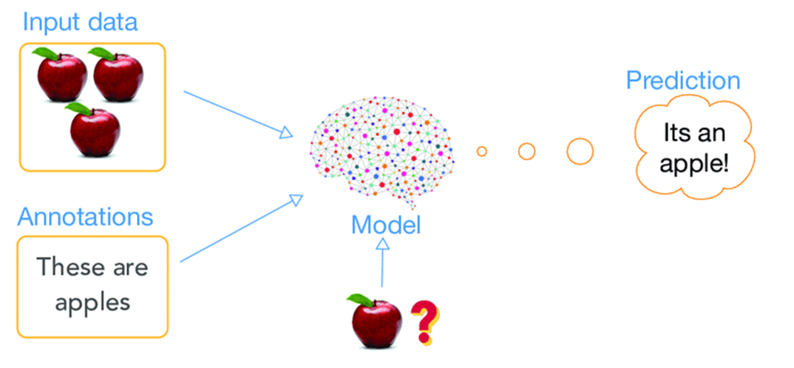
Training Data and Testing Data
Training Set
Training Data Label
Testing Data

Slide 19
Validating Scarce Data
Cross-validation technique
Can be used to train and validate a model on the same data.
The training data is partitioned.
The model is trained using all but one of the partitions, and tested on the remaining partition.
The partitions are then rotated several times so that the model is trained and evaluated on all of the data.
The mean of the model's scores on each of the partitions is a better estimate of performance in the real world than an evaluation using a single training/testing split.

Slide 20
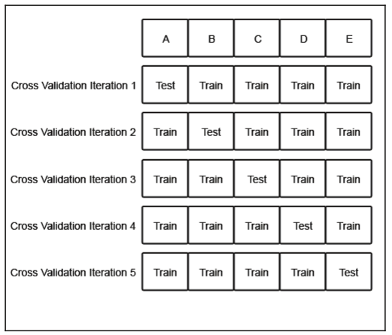
Operating Cross-Validation
The original dataset is partitioned into five subsets of equal size labeled A through E.
Initially the model is trained on partitions B through E, and tested on partition A.
In the next iteration, the model is trained on partitions A, C, D, and E, and tested on partition B.
The partitions are rotated until models have been trained and tested on all of the partitions.
Cross-validation provides a more accurate estimate of the model's performance than testing a single partition of the data.

Slide 21
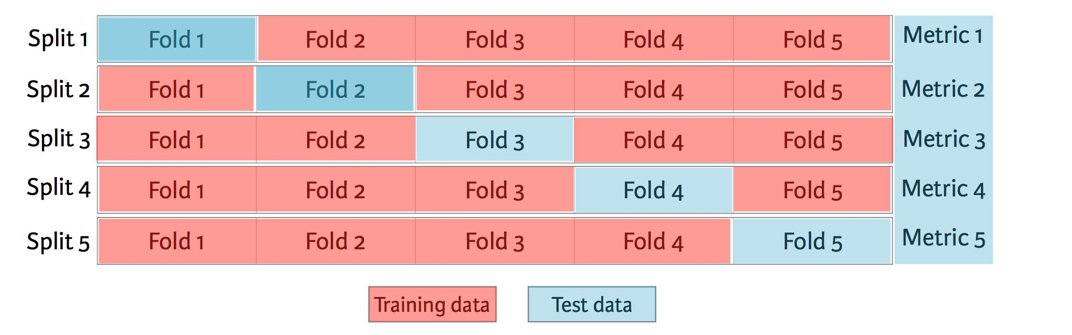
Operating Cross-Validation

Slide 22
How to Measure the Performance of Machine Learning?
Performance metrics measure the amount of prediction error.
Bias
An error from erroneous assumptions in the learning algorithm.
Variance
A type of error that occurs due to a model's sensitivity to small fluctuations in the training set.

Slide 23
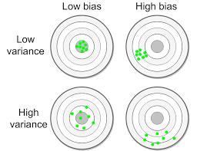
Types of Bias and Variance
A model with high variance over-fits the training data.
A model with high bias under-fits the training data.
So, find the most proper technique to reduce bias and variance (trade-off).
The Best

Slide 24
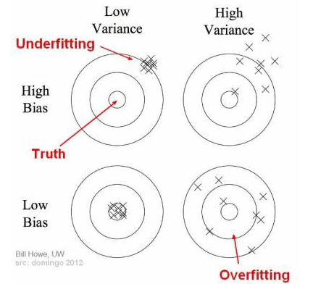
More View on Bias and Variance

Slide 25
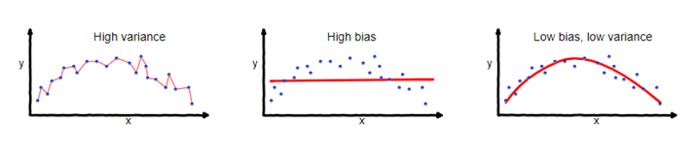
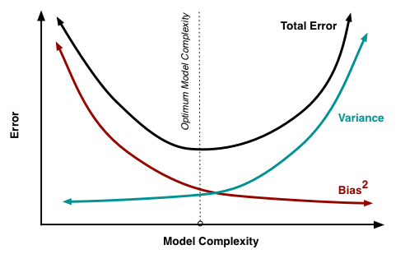
Over, Underfitting and the Trade-Off

Slide 26
Techniques to Reduce High Variance
Get more training examples because a larger the dataset is more probable to get a higher predictions.
Try smaller sets of features because you are overfitting.
Try increasing lambda, so you can not overfit the training set as much. The higher the lambda, the more the regularization applies, for Linear Regression with regularization.

Slide 27
Techniques to Reduce High Bias
Try getting additional features, you are generalizing the datasets.
Try adding polynomial features, make the model more complicated.
Try decreasing lambda, so you can try to fit the data better. The lower the lambda, the less the regularization applies, for Linear Regression with regularization.

Slide 28
The Accuracy of Prediction
The number of correctly predicted data points out of all the data points.
Called as the fraction of instances that were classified correctly.
An intuitive measure of the program's performance.
Does measure the program's performance, but it does not differentiate.
Often used along with Precision (P) and Recall (R), which are other metrics that use various ratios of true/false positives/negatives, namely:
TP = True Positive
TN = True Negative
FP = False Positive
FN = False Negative

Slide 29
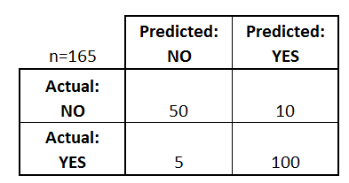



The Accuracy of Prediction
$$ACC=\frac{TP+TN}{TP+TN+FP+FN}$$
$$P=\frac{TP}{TP+FP}$$
$$R=\frac{TP}{TP+FN}$$
Can be calculated by the help of Confusion Matrix.
True Positive (TP) – The case in which the system predicted YES and the actual output was also YES.
True Negative (TN) – The case in which the system predicted NO and the actual output was NO.
False Positive (FP) – The case in which the system predicted YES and the actual output was NO.
False Negative (FN) – The case in which the system predicted NO and the actual output was YES.
Try to calculate this table

Slide 30
An Introduction to Scikit-learn and Other Tools
Scikit-learn
Focused on Machine Learning.
Built on the popular Python libraries NumPy and SciPy.
A library in Python that provides many unsupervised and supervised learning algorithms.
Provides a range of supervised and unsupervised learning algorithms via a consistent interface in Python.
A free machine learning library for Python.

Slide 31
Scikit-learn Supports Various Libraries
NumPy: For any work with matrices, especially math operations.
SciPy: Scientific and technical computing.
Matplotlib: Data visualisation.
IPython: Interactive console for Python.
Sympy: Symbolic mathematics.
Pandas: Data handling, manipulation, and analysis.

Slide 32
Scikit-learn Supports Various Algorithms
Regression: Fitting linear and non-linear models
Clustering: Unsupervised classification.
Decision Trees: Tree induction and pruning for both classification and regression tasks.
Neural Networks: End-to-end training for both classification and regression. Layers can be easily defined in a tuple.
SVMs: for learning decision boundaries.
Naive Bayes: Direct probabilistic modelling.

Slide 33
Scikit-learn Supports Various Algorithms
Ensemble Methods: Boosting, Bagging, Random Forest, Model voting and averaging.
Feature Manipulation: Dimensionality reduction, feature selection, feature analysis.
Outlier Detection: For detecting outliers and rejecting noise.
Model selection and validation: Cross-validation, Hyperparameter tuning, and metrics.

Slide 34
More on Scikit-learn
Machine Learning in Python - https://scikit-learn.org/stable/
An introduction to machine learning with scikit-learn - https://scikit-learn.org/stable/tutorial/basic/tutorial.html#

Slide 35
Platform Scikit-learn
Windows
Ubuntu Linux
Mac OS
Using
Anaconda
Pip
Google Colab
See the guide in https://scikit-learn.org/stable/install.html#install-official-release

Slide 36
A Brief on Google Colab
A free online cloud-based Jupyter notebook environment that allows us to train our machine learning and deep learning models on CPUs, GPUs, and TPUs.
CPU – Central Processing Unit.
GPU – Graphic Processing Unit.
TPU – Tensor Processing Unit.

Slide 37
Installing and Practicing Google Colab
Takes only 5 minutes.
Follow online instruction such as in:
https://medium.com/@dede.brahma2/cara-menggunakan-google-colaboratory-5f5e4393ac2f
Learn to code Python. There are abundant resources such as:
https://colab.research.google.com/github/cs231n/cs231n.github.io/blob/master/python-colab.ipynb#scrollTo=DL5sMSZ9L9eq

Slide 38
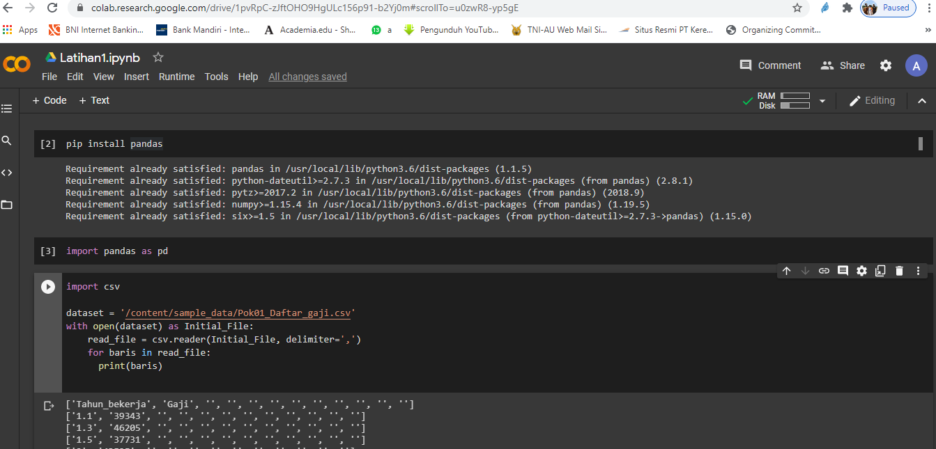
An Example of Python Coding in Colab

Slide 39
Thank You for Today
Keep Spirit!

